Slide 1
R Programming
Understanding data types, reading data in R, data manipulation techniques

Slide 2
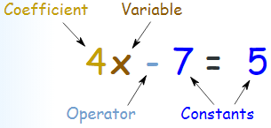
Variables in R
A variable provides us with named storage that our programs can manipulate.
A valid variable name consists of letters, numbers and the dot or underline characters.
The variable name starts with a letter or the dot not followed by a number.
Variable Assignment
The variables can be assigned values using leftward (<-), rightward (->) and equal to (=) operator.
The values of the variables can be printed using print() or cat() function.
The cat() function combines multiple items into a continuous print output.
Notes:
Can a Variable name in R be started with a number?
How many ways are there in R to store a value in a variable?
What is the basic difference between Print and Cat function?

Slide 3
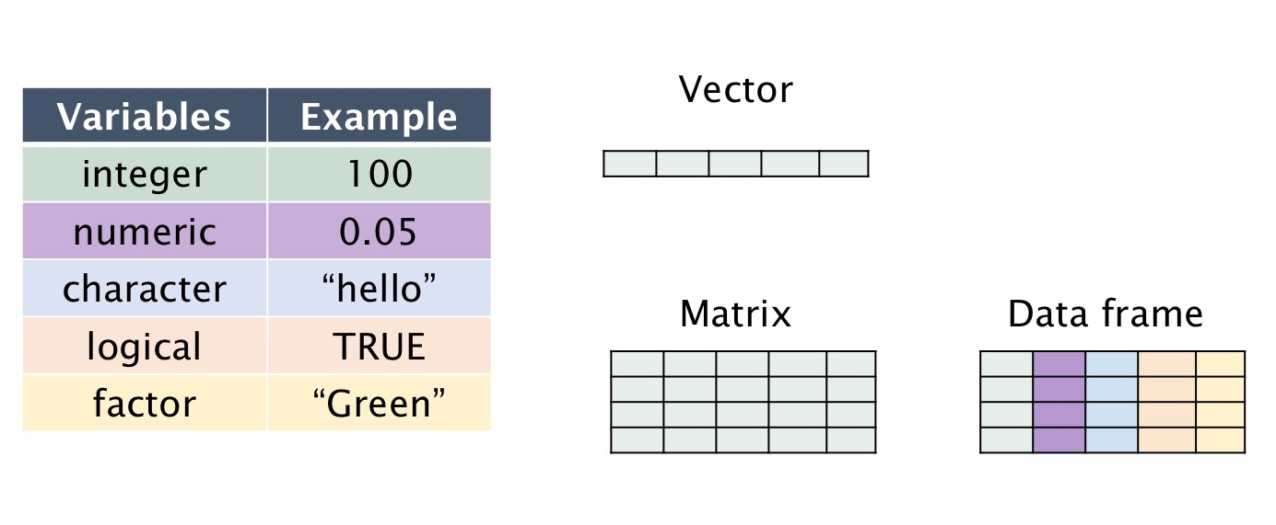
Variables in R
# Assignment using equal operator.
var.1 = c(0,1,2,3)
# Assignment using leftward operator.
var.2 <- c("learn","R")
# Assignment using rightward operator.
c(TRUE,1) -> var.3
print(var.1)
cat ("var.1 is ", var.1 ,"\n")
cat ("var.2 is ", var.2 ,"\n")
cat ("var.3 is ", var.3 ,"\n")
When we execute the above code, it produces the following result −
[1] 0 1 2 3
var.1 is 0 1 2 3
var.2 is learn R
var.3 is 1 1

Slide 4
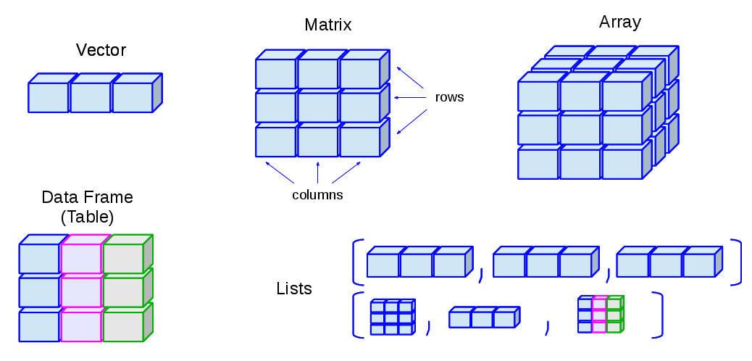
Data Structures in R
Vectors
Most Simplest structure in R
If data has only one dimension, like a set of digits, then vectors can be used to represent it.
Matrices
Used when data is a higher dimensional array
But contains only data of a single class Eg : only character or numeric

Slide 5
Data Structures in R
Data Frames
It is like a single table with rows and columns of data
Contains columns or lists of different data
Lists
Used when data cannot be represented by data frames
It contain all kinds of other objects, including other lists or data frames
Very Flexible

Slide 6
Vectors
A vector is a sequence of data elements of the same basic type.
o <- c(1,2,5.3,6,-2,4) # Numeric vector
p <- c("one","two","three","four","five","six") # Character vector
q <- c(TRUE,TRUE,FALSE,TRUE,FALSE,TRUE) # Logical vector
o;p;q
[1] 1.0 2.0 5.3 6.0 -2.0 4.0
[1] "one" "two" "three" "four" "five" "six"
[1] TRUE TRUE FALSE TRUE FALSE
Notes:
Can we create a vector of logical values?

Slide 7
Vectors
> o[q] # Logical vector can be used to extract vector components
[1] 1 2 6 4
> names(o) <- p # Give each component a name
> o
one two three four five six
1.0 2.0 5.3 6.0 -2.0 4.0
> o["three"] # Extract your components by "calling" their names
three
5.3
Notes:
In vector we can use only index position number to access the values? True/ False?
What command is used to assign the labels to the vector’s individual values?

Slide 8
Matrices
A matrix is a collection of data elements arranged in a two-dimensional rectangular layout.
Same as vector, the components in a matrix must be of the same basic type.
The following is an example of a matrix with 4 rows and 3 columns.
t <- matrix(1:12,nrow=4,ncol=3,byrow = FALSE)
t
[,1] [,2] [,3]
[1,] 1 5 9
[2,] 2 6 10
[3,] 3 7 11
[4,] 4 8 12
Notes:
In Matrix we can store data of different data type. True / False?
What is the use of nrow parameter in Matrix?
What is the use of byrow parameter in Matrix?

Slide 9
Matrices
Similar to vectors, matrices also use [] to reference elements.
> t[2,3] # component at 2nd row and 3rd column
[1] 10
> t[,3] # 3rd column of matrix
[1] 9 10 11 12
> t[4,] # 4th row of matrix
[1] 4 8 12
> t[2:4,1:3] # rows 2,3,4 of columns 1,2,3
[,1] [,2] [,3]
[1,] 2 6 10
[2,] 3 7 11
[3,] 4 8 12
Notes:
In matrix named Mat, how to access the component at 3rd row, 6 column?
In matrix named Mat, how to access the entire 3rd row?
In matrix named Mat, how to access the entire 4th col?

Slide 10
Data frames
A data frame is more general than a matrix, in that different columns can have different basic data types.
> d <- c(1,2,3,4)
> e <- c("red", "white", "red", NA)
> f <- c(TRUE,TRUE,TRUE,FALSE)
> mydata <- data.frame(d,e,f)
> names(mydata) <- c("ID","Color","Passed") # variable names
> mydata
ID Color Passed
1 1 red TRUE
2 2 white TRUE
3 3 red TRUE
4 4 <NA> FALSE
Notes:
Dataframe in R can contain only the same data type. True/ False?
Which is closest match of Dataframe? Vector/ List/ Matrix?
What is the syntax/function to create a data frame?
Can we assign the names to rows of the data frame?
What is the syntax to assign the column names in the data frame?

Slide 11
Data frames
Extracting components from data frames is somehow similar to what we did for matrices, but after assigning names to each column (variable), it becomes more flexible.
> mydata$ID # try mydata["ID"] or mydata[1]
[1] 1 2 3 4
> mydata$ID[3] # try mydata[3,"ID"] or mydata[3,1]
[1] 3
> mydata[1:2,] # first two records
ID Color Passed
1 1 red TRUE
2 2 white TRUE
Notes:
Extracting components from data frame is similar to: List / Vector / Matrix?
What are the various ways to extract the entire column from the data frame?

Slide 12
List
A list is a generic vector containing other objects.
There is no restriction on data types or length of the components.
# a list with a vector, a matrix, a data frame defined earlier and a scalar
> p=c("one", "two", "three", "four", "five", "six")
> l <-list(vec=p, mat=t, fra=mydata, count=3)
> l
l$vec
[1] "one" "two" "three" "four" "five" "six"
l$mat
[,1] [,2] [,3]
[1,] 1 5 9
[2,] 2 6 10
[3,] 3 7 11
[4,] 4 8 12
Notes:
Is there any restriction regarding data type the lists can support?

Slide 13
List
l$fra
ID Color Passed
1 1 red TRUE
2 2 white TRUE
3 3 red TRUE
4 4 <NA> FALSE
l$count
[1] 3
> l$vec # extract components from list
[1] "one" "two" "three" "four" "five" "six"
> l$mat[2,3]
[1] 10
> l$fra$Color
[1] red white red <NA>
Levels: red white

Slide 14
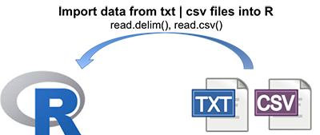
Reading and writing CSV files
Example of importing CSV data are provided below.
Read from a Comma Delimited Text File
# first row contains variable names
# “row.names” assigns the variable id to row names
# If we do not specify row.names then it would create another running serial number to it
mydata <- read.csv("empdata.csv", header=TRUE, row.names="Employee_ID")
mydata
Write to Comma Delimited Text File
write.csv(mydata, "MyEmpData.csv")
Notes:
Which parameter is used to assign the ID variable to Row Names?
What will be behavior if we do not specify the ID variable while importing from the CSV file?
What is the function to write the data frame to CSV file?

Slide 15
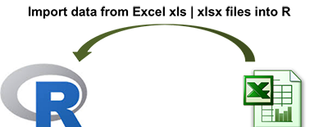
Importing data from excel
From Excel
You can use the xlsx package to access Excel files. The first row should contain variable/column names.
install.packages("xlsx")
library(xlsx)
write.xlsx(mydata, "EmployeeSales.xlsx", row.names= F)
mydata <- read.xlsx("EmployeeSales.xlsx", 1)
mydata
# read in the worksheet named mysheet
mydata <- read.xlsx("EmployeeSales.xlsx", sheetName = "Sheet1")
mydata
Notes:
Which package we need to install before reading data from the excel file?
How to install and import the package?
What is the function to set the current working directory?
An excel file has multiple sheets, when we import from an excel file, how it will figure out from which sheet the data is to be imported? Specify both the ways.

Slide 16
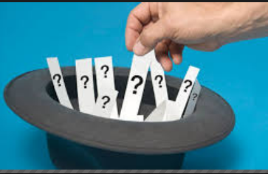
Selecting rows/observations
Suppose you have a data frame, df - consisting of three vectors that consist of information such as height, weight, age.
df <- data.frame( c( 183, 85, 40), c( 175, 76, 35), c( 178, 79, 38 ))
names(df) <- c("Height", "Weight", "Age")
# All Rows and All Columns
df[,]
# First row and all columns
df[1,]
# First two rows and all columns
df[1:2,]
Notes:
Which 2 functions can be used to specify the column names of the data frame?
Which function can be used to specify the row names of the data frame?

Slide 17
Selecting rows/observations
# First and third row and all columns
df[ c(1,3), ]
# First Row and 2nd and third column
df[1, 2:3]
# First, Second Row and Second and Third Column
df[1:2, 2:3]
Notes:
How to get first and second row and all columns
How to get second Row and 2nd and third column

Slide 18
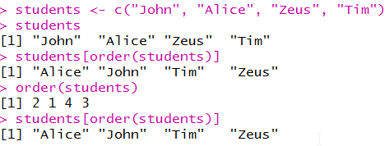
Order data
order() returns the element order that results in a sorted vector
Application: Very useful for sorting dataframes

Slide 19


